Slide 1

Our Journey so far
(2017 to 2019)
SCOTT COGAR
Inaugural Chair (Retiring)

Slide 2
initial funding from City of Greater Geraldton - Growing Greater Geraldton Growth Plan
industry-lead group to focus on growing the
Tourism Economy of Geraldton and our region
group made up of senior Tourism stakeholders including Tourism operators and government

Slide 3












Founding Members - Established in May 2017

Slide 4
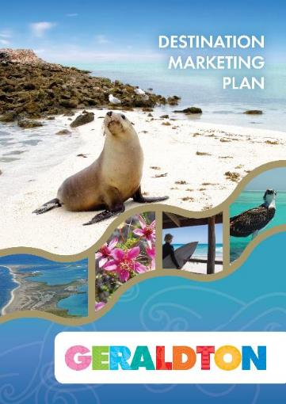
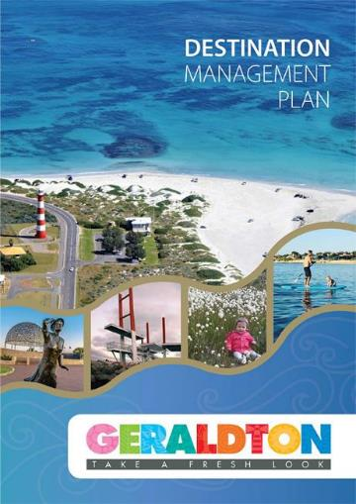
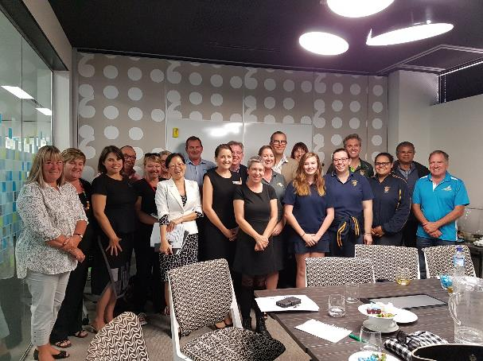
Defining a shared Vision
and how to achieve it
June 2017

Slide 5
Estimate of current Geraldton Tourism Economy
Visitor economy of $148m per annum
supports 770+ jobs
5.4% of local employment
62% from accommodation & food
19% from retail
with abundant spare capacity to grow
TOURISM ECONOMY
of City of Greater Geraldton
Source: Progress Mid West
Tourism Cluster Report May 2017

Slide 6
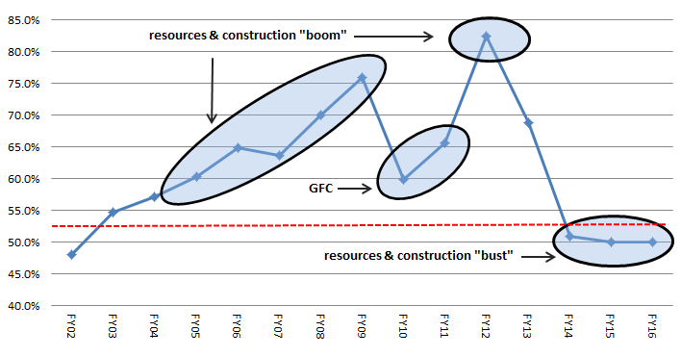
Annual Hotel Occupancy for past 15 Years
HOTEL OCCUPANCY
in City of Greater Geraldton
(Commercial Accommodation)
Source: Australian Bureau of Statistics

Slide 7
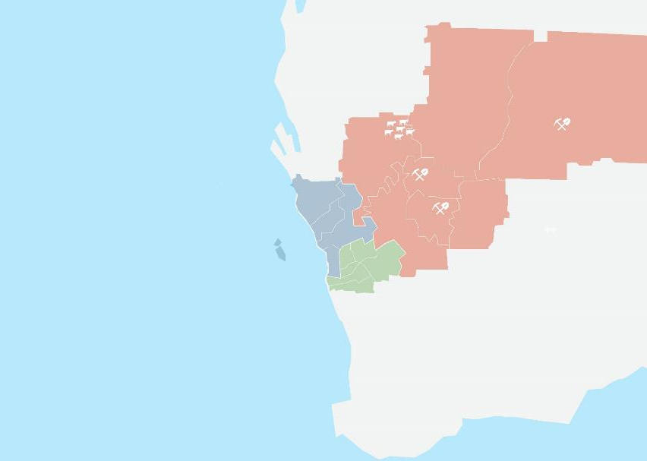
CITY OF GREATER GERALDTON
(Hub)
KALBARRI
(North)
GEOTRAILS
(East)
PORT DENISON
(South)
ABROLHOS ISLANDS
(West)
Hub & Spoke
TOURISM MODEL
Experiences in Geraldton
and day trips from Geraldton

Slide 8
$200m Annuallyby 2020/21
facilitate COMMUNITY PARTICIPATION
enhance VISITOR EXPERIENCES
build COLLABORATION & PARTNERSHIPS
build DESTINATION CAPABILITY
Transforming our
TOURISM ECONOMY to $200m by 2020/21

Slide 9
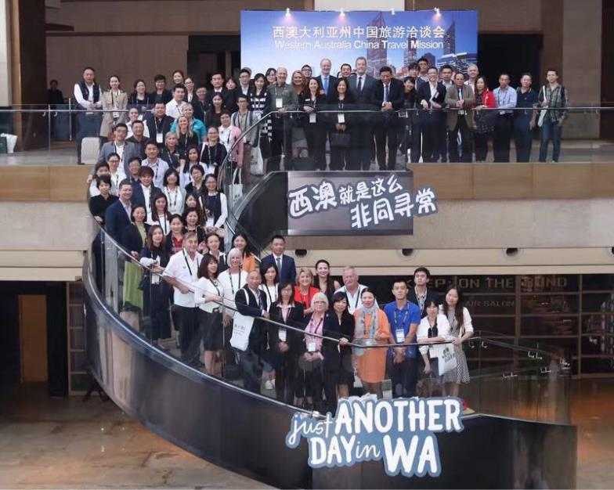
Quick Win initiatives
Zhoushan Tourism Convention
Geraldton represented in China
China Ready Training
delivered to 35 local businesses
in conjunction with TCWA
Crayfish to the Plate
lobby for stable lobster quota for
local residents & tourism businesses
Tourism Investment Summit
inaugural summit in May 2018
attended by around 250 delegates
First Qantas Boeing 737 Charter
sponsored charter flight to support
Investment Summit and Tourism
Tourism WA Board & Execs visit
recent 3 day visit to Geraldton for
local famils, meetings & feedback

Slide 10
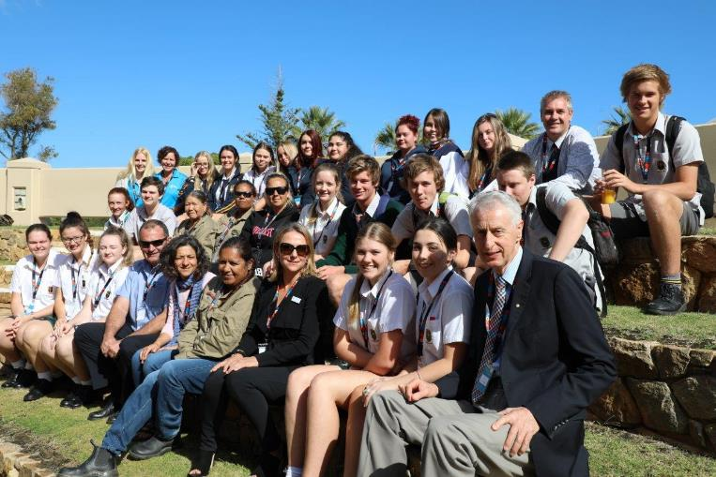
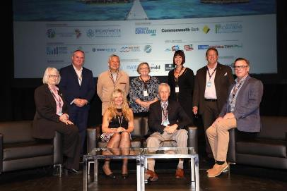
Growing Greater Geraldton
Tourism Investment Summit May 2018
Around 250 delegates engaged
with a panel of high profile tourism industry speakers about Growing Greater Geraldton Tourism at the Queens Park Theatre in Geraldton.

Slide 11
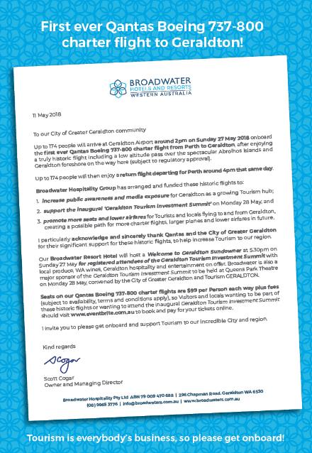
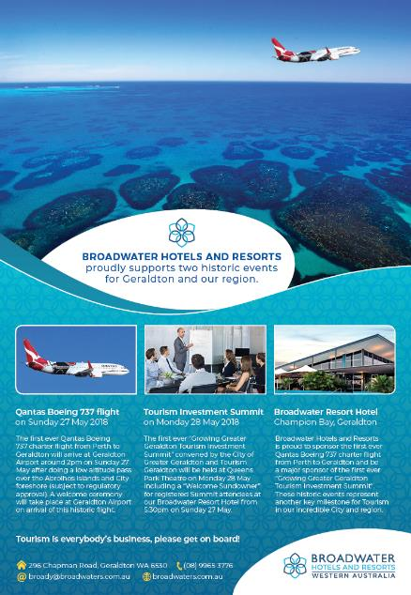

Slide 12
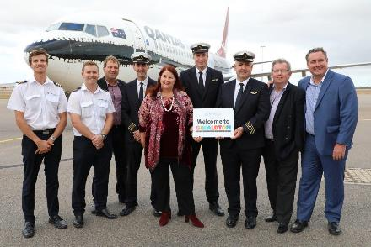
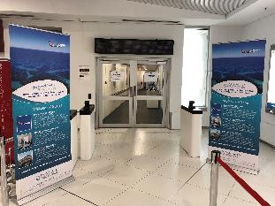
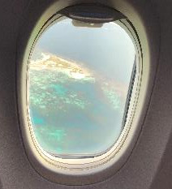
Sunday 27 May 2018 historic first ever
QANTAS BOEING 737 CHARTER TO GERALDTON
Qantas Gate 15
Terminal 4 Perth
Flight over the spectacular
Houtman Abrolhos Islands
Qantas Flight QF 1360
Captain Gary McKenzie

Slide 13
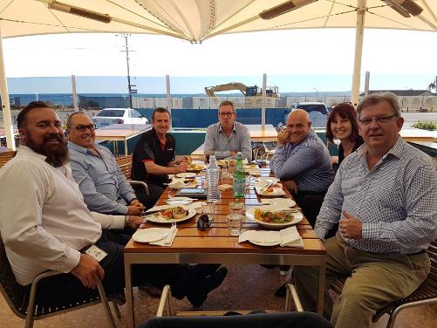
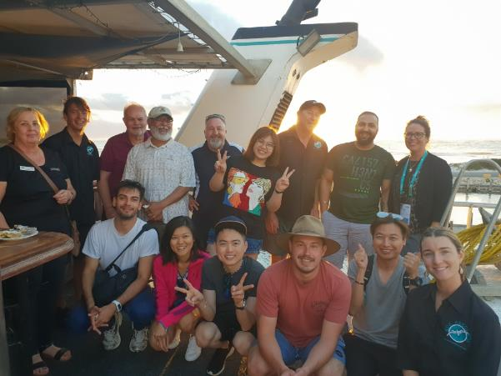
Developing partnerships and encouraging collaboration
Meeting with Australia’s Coral Coast
and Qantas WA Management
Hosting seven Australian Tourism Exchange (ATE) famil groups in April 2019

Slide 14
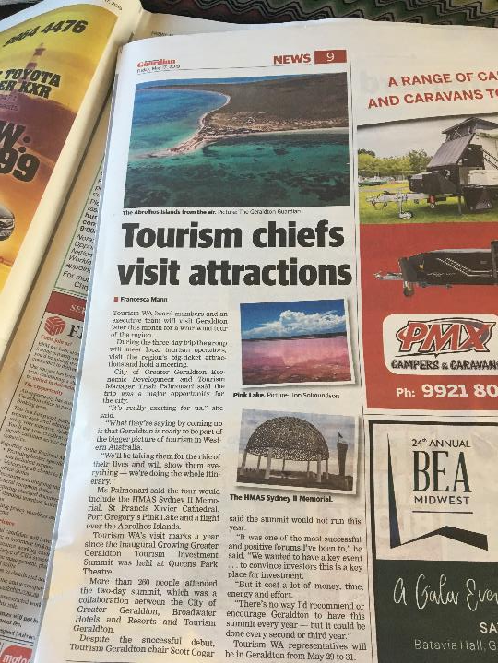
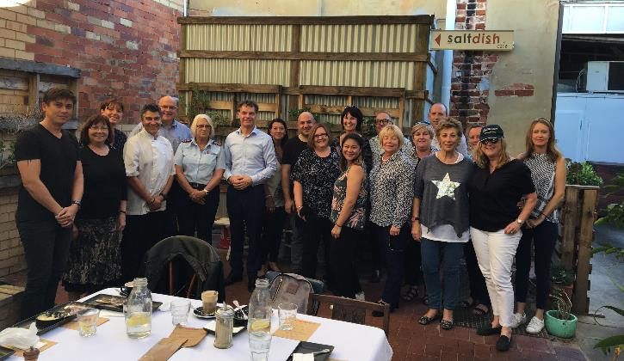
Developing partnerships and encouraging collaboration
Showcasing Geraldton to the entire Tourism WA Board
and Executive Management Team in May 2019

Slide 15
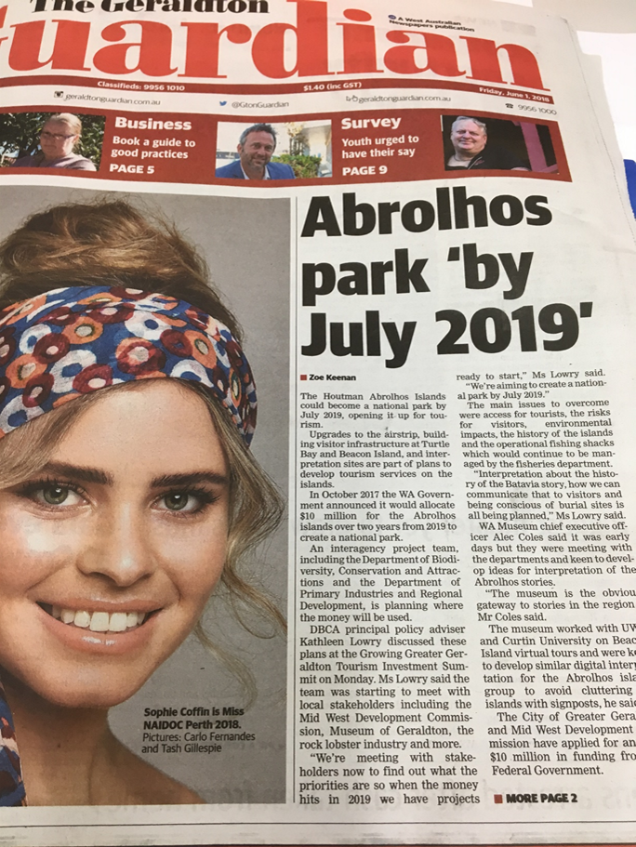
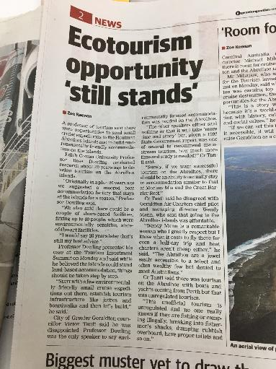
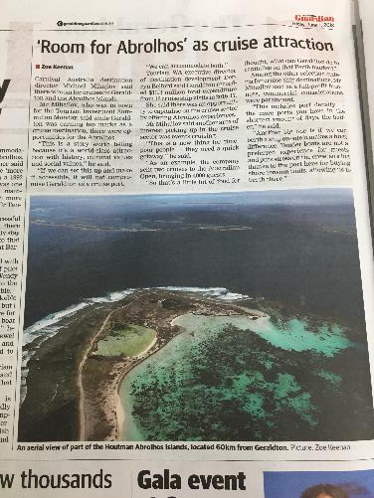
A voice for our local Tourism Industry…

Slide 16

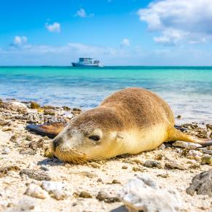
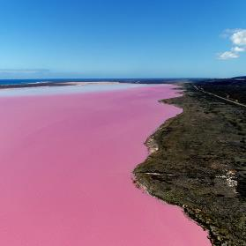
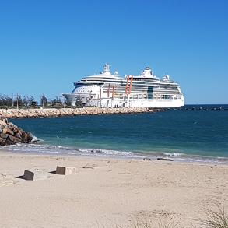
Leverage our most unique
DESTINATION PULL FACTORS
to grow our Tourism Economy
1
2
3
Houtman Abrolhos Islands
Pink Lake
Cruise Ships

Slide 17
Leverage our most unique
DESTINATION PULL FACTORS
to grow our Tourism Economy
1
Abrolhos Islands is a ‘game changer’, adding $10m+ annually & 50+ FTE jobs.
2
Pink Lake is a huge drawcard for Chinese Tourists, our biggest inbound market.
3
Cruise Ships contributed $7m and 23 FTE jobs in 2015/16 with room to grow.

Slide 18

World class opportunity
GOING TO WASTE
Economic modelling for Tourism for the Abrolhos Islands suggested:
Economic Return on Investment (EROI) of $10m within 5 years; and
EROI of around 200% after 10 years.
Over the first decade, resultant growth in Tourism was projected to:
increase business revenues by over $70 million
increase economic benefit by over $100 million
increase direct local employment by 50+ FTE jobs
This represents 6%+ expansion of current Geraldton Tourism Economy.

Slide 19

Where to from here… some immediate priorities
Virgin Australia no longer flying to Geraldton
High cost of Airfares to/from Perth (no competion)
Poor Air Connectivity to other popular destinations
World class tourism at Abrolhos Islands is overdue
Further leverage visitor experiences in Geraldton
More reliable lobster supply for locals and tourism
Target Daily flights from Japan to Perth from Sep 19
… exciting times ahead

Slide 20
Thank you
and best wishes

